Slide 1
Travis Research Europe
Providing a complete research programme to search & selection consultancies and direct to corporate clients
www.travisresearch.co.uk
+ 44 (0) 1442 828846

Slide 2
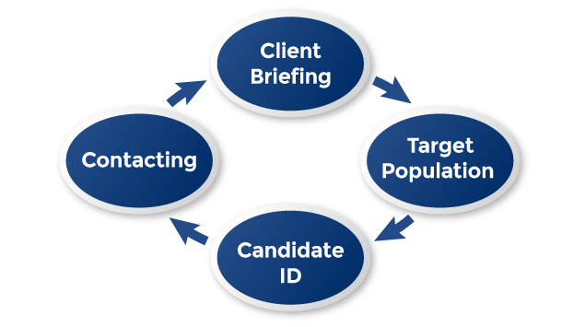
THE CONCEPT
Travis Research Europe Ltd is an executive research company operating on a pan-European and Worldwide basis. We are able to provide a complete research programme to search and selection consultancies and direct to corporate clients across a wide range of market sectors.
We can undertake ‘one off’ or multiple recruitment projects, and also offer a range of market intelligence services such as talent mapping, talent pipelining, salary surveys and CV verification. Travis Research are members of the Executive Research Association, which sets out standards for ethics in the executive research industry.
We can undertake:
Candidate identification and approaching
Talent mapping
Market insight / intelligence
Talent pipelining
Salary surveys
CV verification
Bespoke or multiple recruitment projects
www.travisresearch.co.uk
@MinOfTalent
+ 44 (0)1442 828846
Notes:
Add image

Slide 3
HOW TRAVIS RESEARCH TRANSFORMS THE RESOURCING MODEL
We are research and intelligence led - we look for who is best in class.
We build an accurate picture of the resourcing environment in which our clients are operating.
We can provide information to our clients in advance of a decision on whether to recruit, as to the likelihood of success and whether the talent on the outside of the organisation is better than the talent on the inside.
We can create banks of candidates for regularly recruited roles, or to aid succession planning for critical appointments.
The process is transparent and flexible – the client remains in control.
Our aim is to become a valued advisor to the client – this is not a transactional model. We aim to be with clients for the long term and will appoint a Relationship Director, who will develop a deep understanding of the business and its drivers.
The resourcing decisions that our clients make will be well informed.
www.travisresearch.co.uk
@MinOfTalent
+ 44 (0)1442 828846

Slide 4
WHAT WE OFFER
We offer our clients a choice of operating models:
We undertake one off or multiple recruitment projects, allowing our clients a choice of how much work we undertake on their behalf. In simple terms we split the recruitment process into its component parts, from writing a job description, through candidate identification and onto reference checking. We encourage our clients to consider how much of the process they can undertake for themselves and how much outside assistance they require. We charge on a per diem basis for the work that we undertake.
We provide assistance with succession planning for senior roles by identifying interested, talented and affordable candidates in advance of the vacancy. This method assists the client to decide whether they actually need to “go to market” or whether they should appoint from their internal resources.
We work with clients on roles, for which they have a regular need to recruit, by building a Talent Pool of interested and affordable candidates who can be called forward when the need arises. This dramatically reduces the length of the recruitment process and the time that a vacancy needs to be gapped.
Regardless of how we assist our clients we continue to offer a commentary on the recruitment market place with incisive feedback.
www.travisresearch.co.uk
@MinOfTalent
+ 44 (0)1442 828846

Slide 5
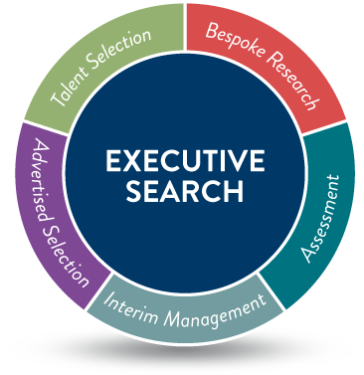
WE CAN UNDERTAKE
Candidate identification and approaching
Talent mapping
Market insight / intelligence
Talent pipelining
Salary surveys
CV verification
Bespoke or multiple recruitment projects
Flexible project management
www.travisresearch.co.uk
@MinOfTalent
+ 44 (0)1442 828846

Slide 6
ADVANTAGES
We develop a deep knowledge of our clients and their markets
Focused, flexible and transparent
Costs are visible and highly competitive – there is no drop in quality
The client gets what they pay for; they are in control, no frills
Allows the client to recruit from competitors via a third party
www.travisresearch.co.uk
@MinOfTalent
+ 44 (0)1442 828846

Slide 7
A TYPICAL ASSIGNMENT
Client Briefing
An initial meeting or telephone briefing is arranged to ascertain the requirements of the client. Time and cost budgets are set in advance and are not exceeded without written authority.
Target Population
A target list is compiled of potential companies, i.e. direct competitors, associated business sectors, product or geography. This is then agreed by the client before candidate identification commences.
Candidate Identification / Mapping of Organizations
Potential candidates are identified within the target population; we then begin to create a report adding profiles wherever possible. This is reviewed with the client and a long list of candidates is created.
Contacting
The potential candidates are contacted to establish their level of interest and initial suitability for the role, (client identity can be protected at this stage if necessary). CV details of candidates who express an interest are presented to the client, where candidates are not interested, feedback is obtained and reported. This information provides clients with real time market insight in terms of employer branding, remuneration & talent in the market. Any information obtained is forwarded to the client.
www.travisresearch.co.uk
@MinOfTalent
+ 44 (0)1442 828846

Slide 8
Managing Director - Sarah El-Rasoul
Sarah is Managing Director of Travis Research. Travis Research is a team of five, experienced executive research consultants.
Sarah started her professional life in the world of law which spanned over 16 years in various departments before settling into property law as a fee earner running Property Law departments.
To achieve work life balance, Sarah joined Heather Travis (Founder of Travis Research Europe) in 1999, one of the market leading organisations in the UK and Europe as a trainee researcher working her way into her current role of Managing Director. Sarah has worked on a variety of senior management executive assignments and is also Director of CER Corporate Executive Research and Membership Secretary of The Executive Research Association. Sarah is actively involved in the training and development programmes currently running with the ERA and is passionate about sharing her experience and training methods with new researchers to help them achieve a positive outlook to executive research and always ensuring there is an excellent candidate experience throughout the process.
Email: sarah@travisresearch.co.uk
Office: 01442 828846
Mobile: 07773 242775
Executive Research Director - Rebecca Cunningham
Email: rebecca@travisresearch.co.uk
Executive Researcher – Lucy Fantham
Email: lucy@travisresearch.co.uk
www.travisresearch.co.uk
@MinOfTalent
+ 44 (0)1442 828846
Notes:
More text about the team

Slide 9
CONTACT US
Travis Research Europe Ltd Unit 25, The Silk Mill Business Park Brook Street Tring Hertfordshire HP23 5EF
Website: www.travisresearch.co.uk
Phone: + 44 (0)1442 828846
Sarah El-Rasoul Mobile: + 44 (0) 7773 242775
Email: sarah@travisresearch.co.uk
@minoftalent
Travis Research Europe Ltd
www.travisresearch.co.uk
@MinOfTalent
+ 44 (0)1442 828846

